Slide 1
House Prices: Advanced Regression Techniques

Slide 2
Modeling

Slide 3
Model Analysis

Slide 4
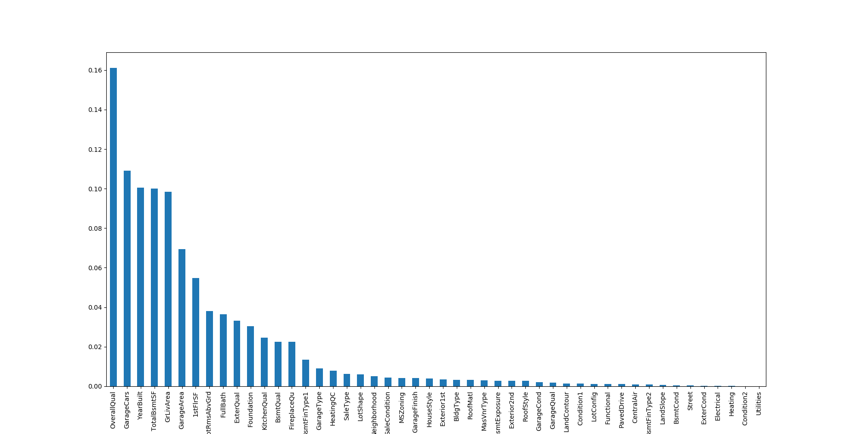
Feature Importance After Modeling

Slide 6
Thank You That's All.

